Slide 1

DRIVER DROWSINESS DETECTION USING MACHINE LEARNING
The American college
bca Department
N.DURAI MURUGAN(21BCA208) GUIDE : DR.S.SHAIK PARVEEN D.MADHAN ALAGAN(21BCA225)

Slide 2
CONTENT
Introduction
Objective
Abstract
Software/Hardware Requirement
Libraries
Algorithm
Modules
scope
Conclusion

Slide 3
Introduction
The Main Aim of the Project Involves controlling vehicle accident & saving drivers life by alerting him.
Whenever Driver’s Eye Blinking Period is more than 10 seconds, we consider this condition under drowsiness i.e, driver is drowse.
Immediate action will be taken as Buzzer will immediately blown up and alerts to wake up the driver.

Slide 4
objectives
Drowsiness Detection Algorithm:
Develop an Efficient Algorithm that can accurately identify sign of drowsiness, such as eye closer, slow eye movements
Alert Mechanism:
Indicate an alerting mechanism, such as audible alarms to promptly notify the driver when signs of drowsiness are detected.
Customizable Thresholds:
Allow users to customize alert thresholds based on individual preferences and driving conditions.

Slide 5
abstract
Driver fatigue is one of the major causes of accidents in the world.
Detecting the drowsiness of the driver is one of the surest ways of measuring driver fatigue.
This system works by monitoring the eyes of the driver and sounding an alarm when he/she is drowsy.
In this project the eye blink of the driver is detected. If the drivers’ eyes remain closed for more than a certain period of time, the driver is said to be drowsy and an alarm is sounded.

Slide 6
Software/hardware requirements
SOFTWARE REQUIREMENT
BACKEND - python
HARDWARE REQUIREMENT
Windows: Windows 11 Home Single Language
Processor: 11th Gen Intel(R) Core(TM) i5-1155G7
Ram: 8.00 GB (7.78 GB usable)
Storage: 512GB SSD

Slide 7
LIBRARIES
OpenCV
Dlib
Pygame
Imutils
Scipy

Slide 8
OpenCV
Opencv (Open Source Computer Vision Library) isn't just a computer vision toolbox; it also offers a powerful machine learning (ML) module.
This integration allows you to extend the realm of your projects beyond basic image processing and delve into tasks like object detection, image classification, and even facial recognition.
OpenCV's ML module provides a suite of algorithms for supervised learning, like Support Vector Machines (SVM).

Slide 9
Dlib
Dlib is a C++ library that goes beyond basic computer vision. It boasts a powerful machine learning (ML) toolkit, making it a versatile option for projects requiring both image processing and intelligent analysis.
Imagine Dlib as your one-stop shop for building ML-powered computer vision applications.
Dlib's ML module offers a variety of algorithms for tasks like classification, regression, and clustering.

Slide 10
Pygame:
Pygame, a popular Python library for creating multimedia games, can join forces with machine learning (ML) to create intelligent and engaging game experiences.
This dynamic duo opens doors for exciting possibilities in game development. Imagine training an AI agent to play your game.
Pygame provides the environment to render your game world, handle user input, and manage game logic.

Slide 11
Imutils:
Imutils, while not an independent machine learning library, acts as a bridge between OpenCV and machine learning by streamlining image preprocessing tasks commonly encountered in computer vision projects with an emphasis on real-time applications.
Imagine Imutils as a pre-processing powerhouse for your machine learning pipeline.
OpenCV offers robust functionalities for computer vision, but working with raw images often requires extensive pre-processing before feeding them into machine learning models.

Slide 12
Scipy:
SciPy (pronounced "Sigh Pie") is a Python library that thrives alongside NumPy to empower your scientific computing endeavors.
While NumPy reigns supreme in array manipulations and numerical operations, SciPy swoops in with a treasure trove of algorithms and functions specifically tailored for scientific and engineering discipline Imagine SciPy as your scientific toolkit.
Special mathematical functions, the kind you'd encounter in scientific computing, are readily available within SciPy's library.

Slide 13
Algorithm
Convolutional Neural Network (CNN)
Support Vector Machines (SVM)

Slide 14
Convolutional Neural Network (CNN)
The (CNN)Convolutional NeuralNetwork is a kind of’ deep learning neurall network that are most typically used to analyse visual information and do some tasks asimage identification, object detection, segmentation.
In a nutshell, consider CNN to be a machine learning framework that can accept an input image and attach important (learning weights and biases) to different aspects/objects in the picture, as well as differentiate in them.
It is a strong image processing algorithm. These methods are currently the best we have for image processing that is automated

Slide 15
Support Vector Machines (SVM)
In machine learning, Support Vector Machines (SVMs) are a powerful algorithm particularly adept at classification tasks.
Imagine you have data points representing different categories, like apples and oranges.
An SVM aims to find a clear dividing line, or hyperplane, in the data space that separates these categories with the largest possible margin. This margin essentially represents the confidence of the classification.

Slide 16
MODULES
Capturing
Face
Recognition
Eye
Recognition
Alert
Blink
Detection

Slide 17
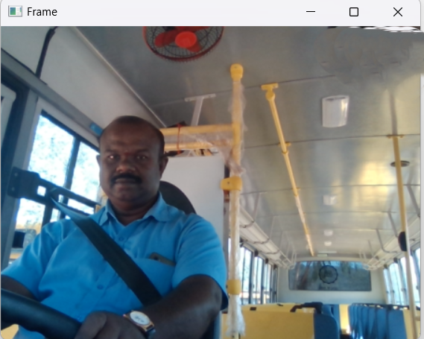
CAPTURING
Use OpenCV to capture the face in the video stream or image captured by a camera.

Slide 18
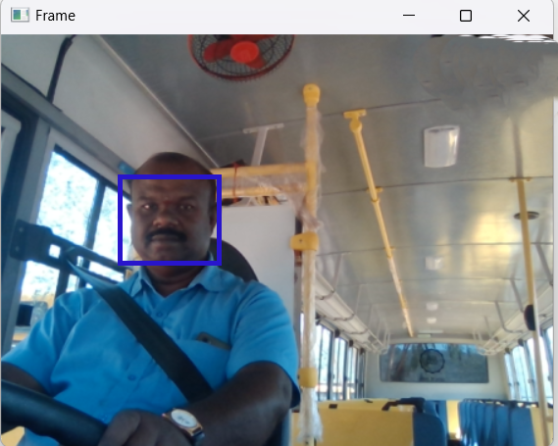
Face Recognition
Use OpenCV to detect the face in the video stream or image captured by a camera.

Slide 19
Eye Recognition
Once you've detected the face, you can focus on the eye regions. Extracting the eye regions is crucial for monitoring eye-related features.

Slide 20
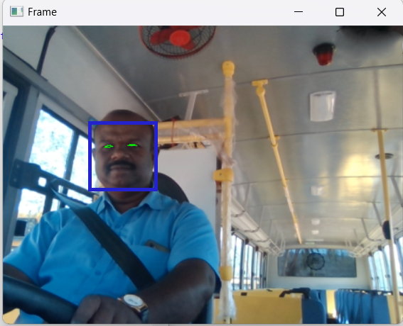
Blink Detection
Use OpenCV to monitor eye blink patterns. You can calculate the eye aspect ratio (EAR) or other blink-related metrics to determine if the driver is blinking at a rate indicative of drowsiness.

Slide 21
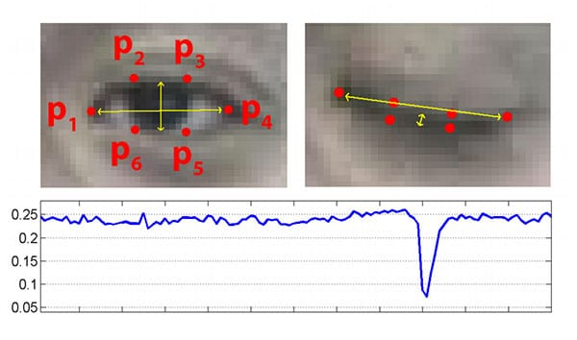
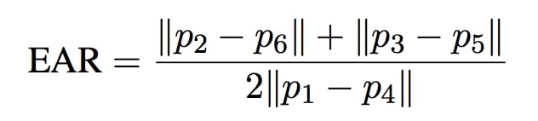
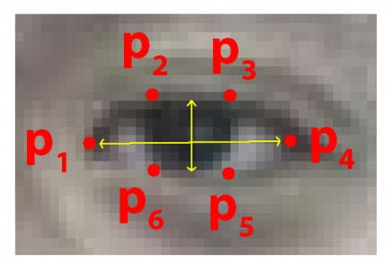

Slide 22
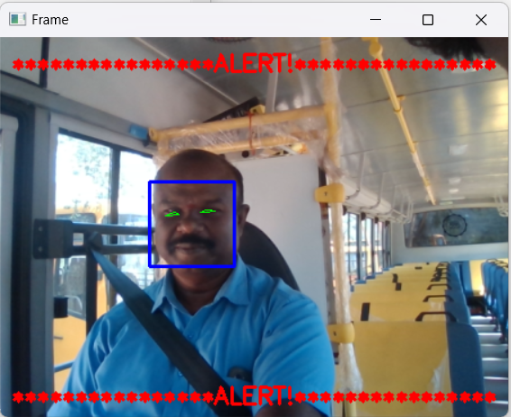
ALERT
Integrate an alert mechanism (such as a sound alert or visual alert) when drowsiness is detected.

Slide 23
scope
This system can be used in any country for driver safety and accident prevention.
Lots of financial loss and Accident can be Decreased.
Traffic Occurance after accident can also eliminated.
Monitoring of Drivers on Trucks and containers , Large Trolleys will be turn in best way.
Roadways and transport companies can use this system.

Slide 24
conclusion
By using this technology we can reduce the road accident due to drowsiness upto some extent.
We can further improve this project with electronic device like eye quality , Night vision camera etc…
We can also control the vehicle IOT just like reducing the speed applying brakes.
Can also send alert the nearest helpline service by using API’s.

Slide 25
Thank you.

